Slide 1
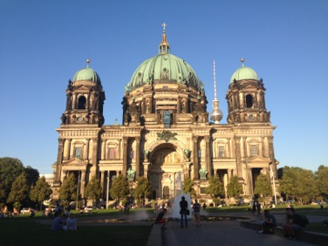
Berlin Trivia
How Well Do You Know Berlin?

Slide 2
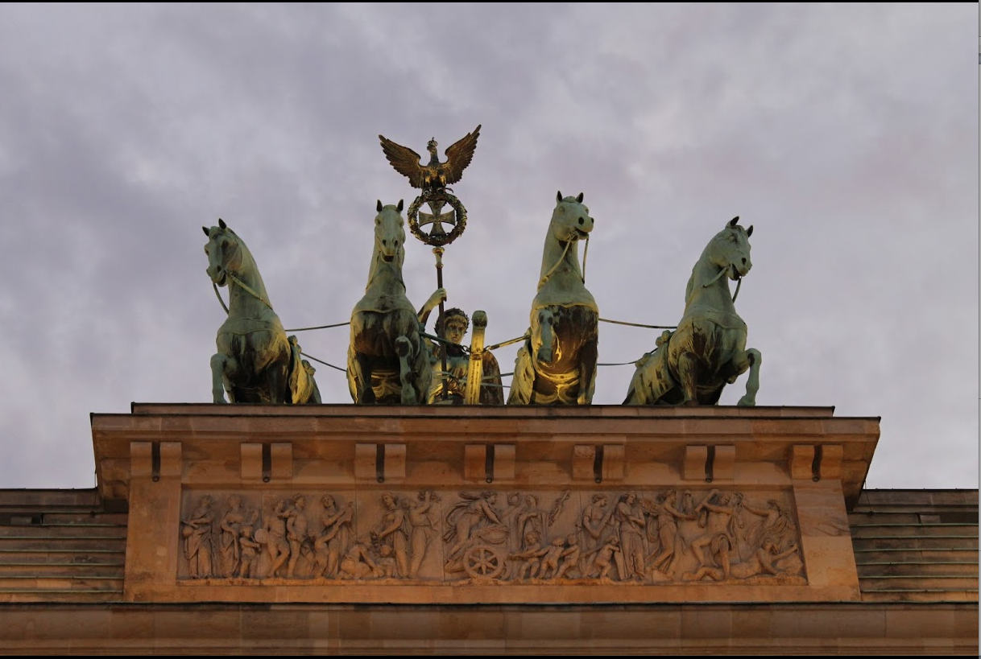
1. When did Berlin first become the capital of Germany?
1715
1871
1933
1991

Slide 3
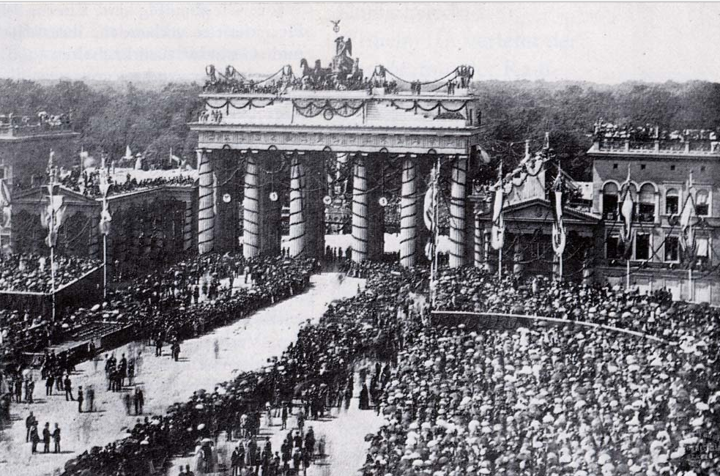
Answer: B
Berlin first became the capital of Germany in 1871.

Slide 4

2. Where in Berlin is the official residence of the President of Germany?
Kanzleramt
Schloss Bellevue
Schloss Charlottenburg
Schloss Sanssouci

Slide 5
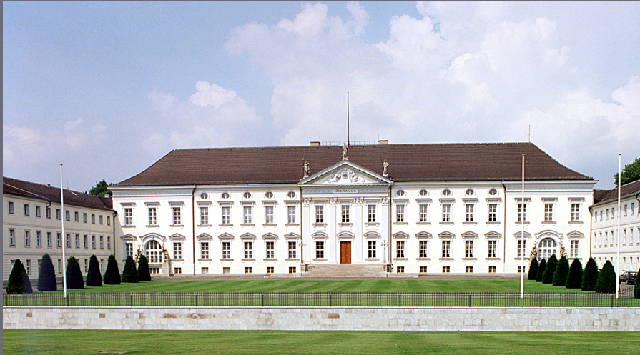
Answer: B
Schloss Bellevue is the official residence of the President of Germany.

Slide 6
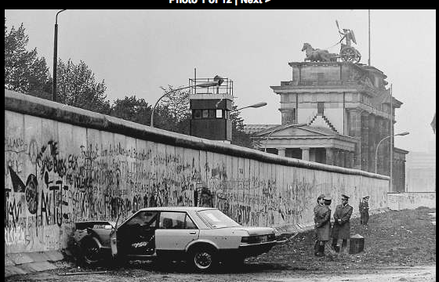
3. How long was the Berlin Wall?
53 miles
78 miles
96 miles
180 miles

Slide 7
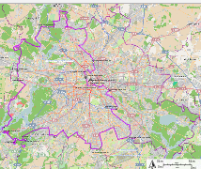
Answer: C
The Berlin Wall was 96 miles long.

Slide 8
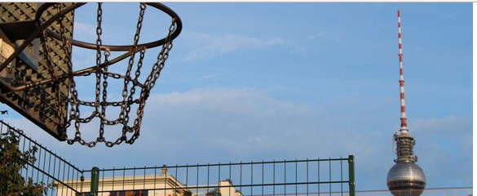
4. What Is the name of Berlin’s basketball team?
Alba Berlin
Eisbaeren Berlin
FC Union Berlin
Hertha Berlin

Slide 9

Answer: A
Alba Berlin is Berlin’s basketball team.

Slide 10
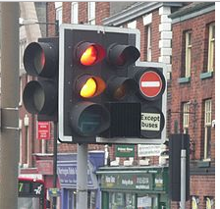
5. The first set of traffic lights in Europe were installed where in Berlin?
Alexander Platz
Charlottenplatz
Nollindorfplatz
Potsdamer Platz

Slide 11
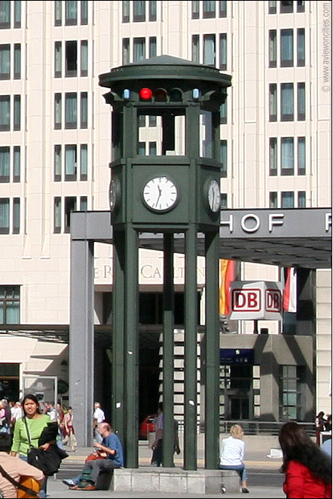
Answer: D
Potsdamer Platz – where one can still see a replica of it.

Slide 12
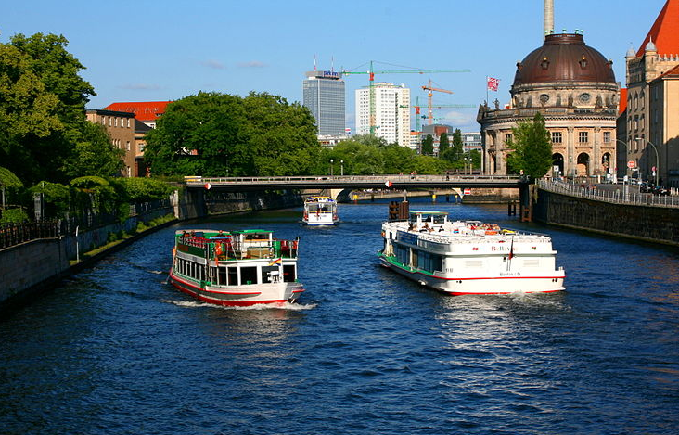
6. Berlin lies on two major rivers, the Spree and the ???
Elbe
Ems
Havel
Oder

Slide 13
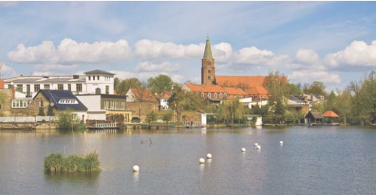
Answer: C
The Havel

Slide 14
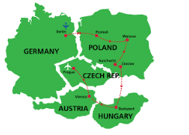
7. Approximately how far west of the Polish border is Berlin?
30 km
70 km
180 km
315 km

Slide 15
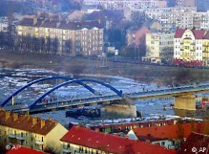
Answer: B
Approximately 70 km from Berlin to the Polish border

Slide 16
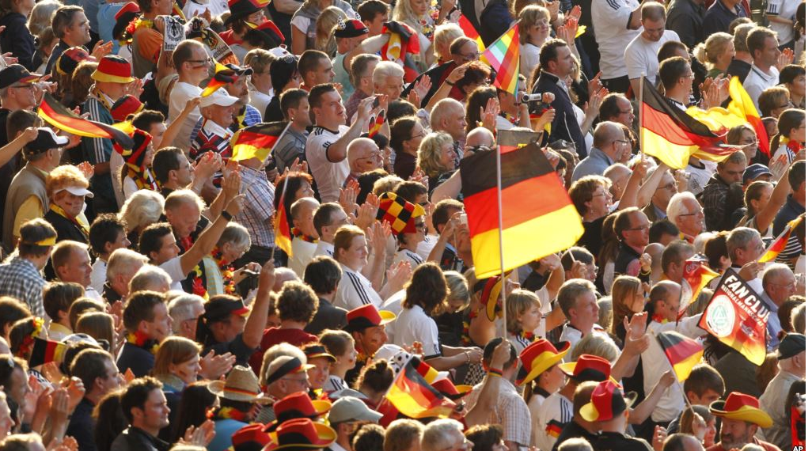
8. What is the approximate population of Berlin?
2.3 million
3.7 million
5.5 million
6.4 million

Slide 17
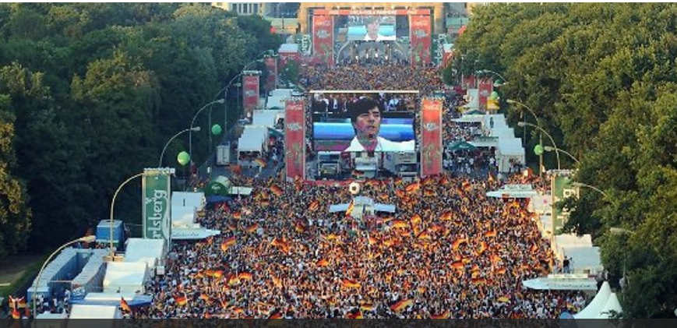
Answer: B
3.7 million

Slide 18
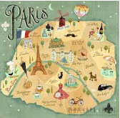
9. Approximately how much bigger in area is Berlin in comparison to Paris?
3 times
5 times
9 times
12 times

Slide 19
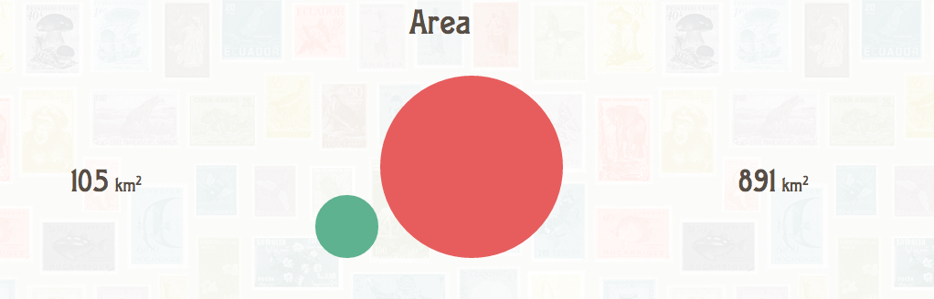
Answer: C
Berlin is approximately 9 times the size of Paris.
Berlin
Paris

Slide 20
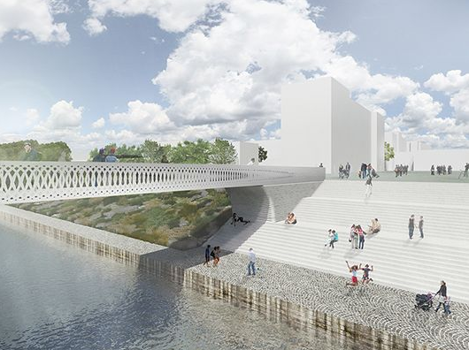
10. Approximately how many bridges does Berlin have?
900
1700
2300
2500

Slide 21
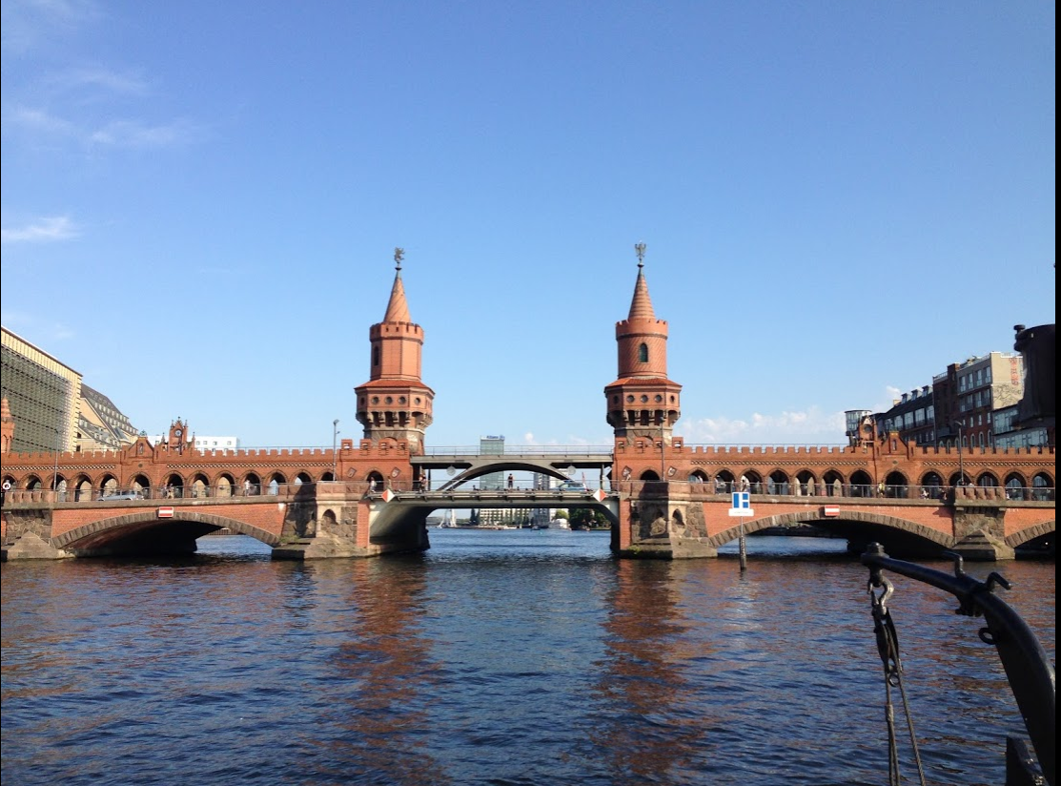
Answer: B
1700 bridges in Berlin – more than in Venice.

Slide 22
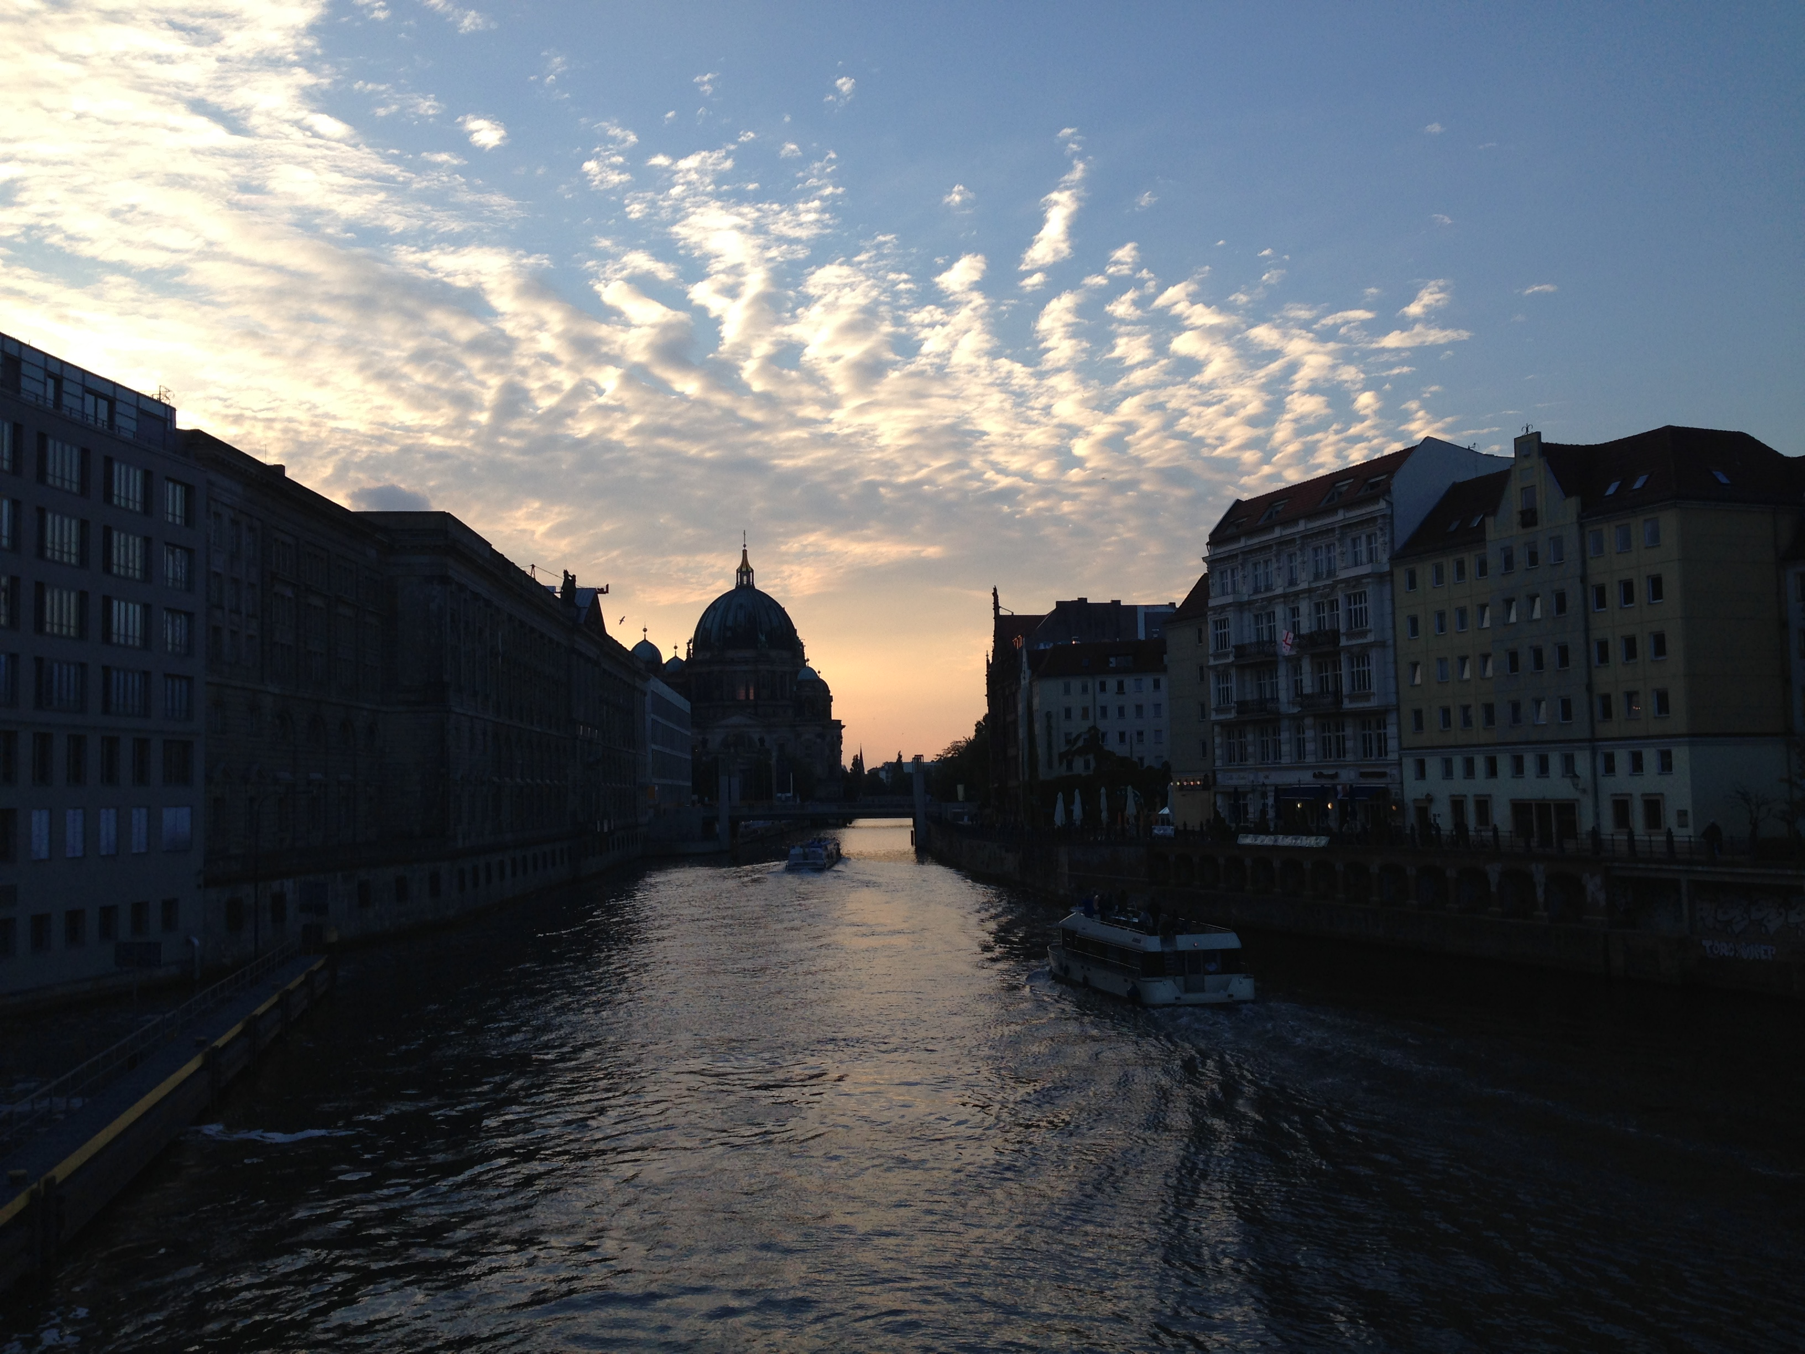
11. How many kilometers of navigable waterways does Berlin have?
180
250
280
350

Slide 23
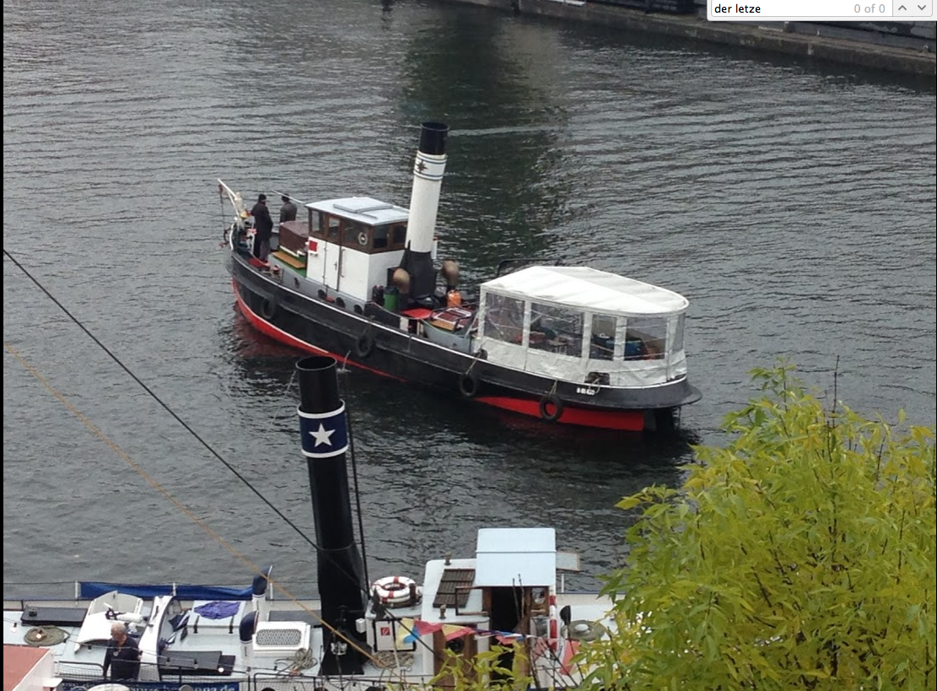
Answer: A
180 km of navigable waterways in Berlin

Slide 24
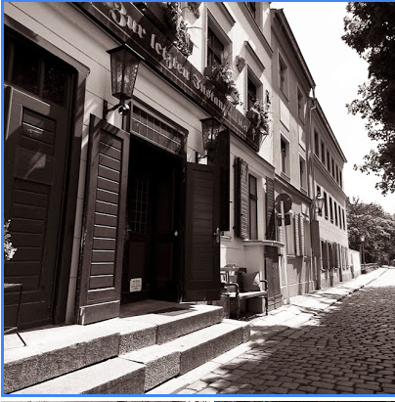
12. Der Letze Instanz is the oldest public house in Berlin. How old is it?
200 years
300 years
400 years
500 years

Slide 25
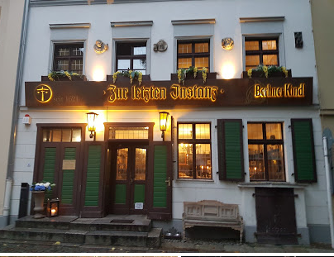
Answer: C
400 years old

Slide 26
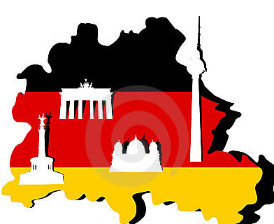
13. Berlin is divided into how many boroughs?
5
7
10
12

Slide 27
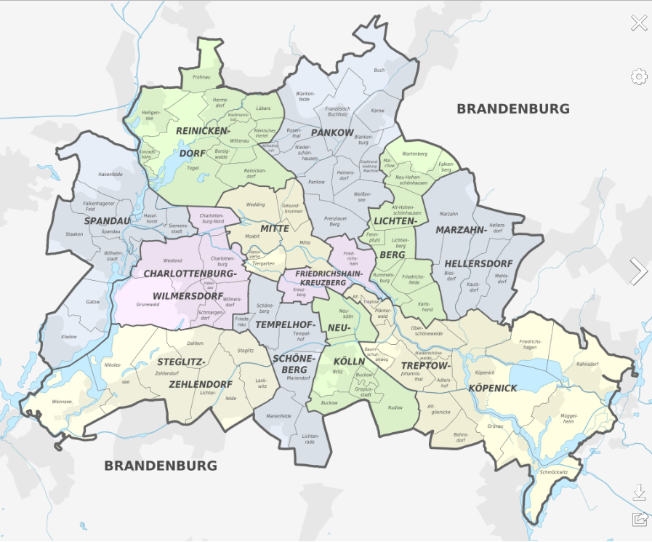
Answer: D
Berlin has 12 boroughs

Slide 28
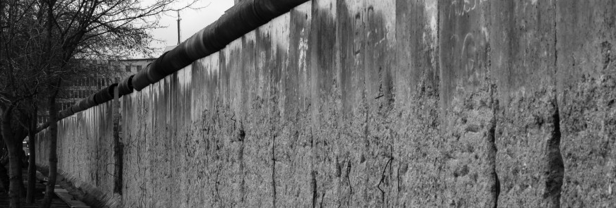
14. In what year was the Berlin Wall built?
1947
1952
1959
1961

Slide 29
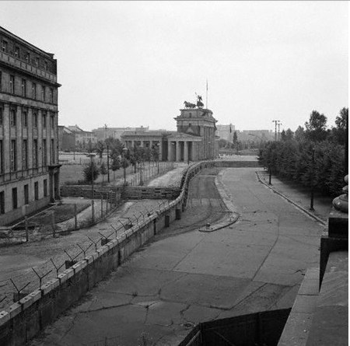
Answer: D
The Berlin Wall was built in 1961.

Slide 30
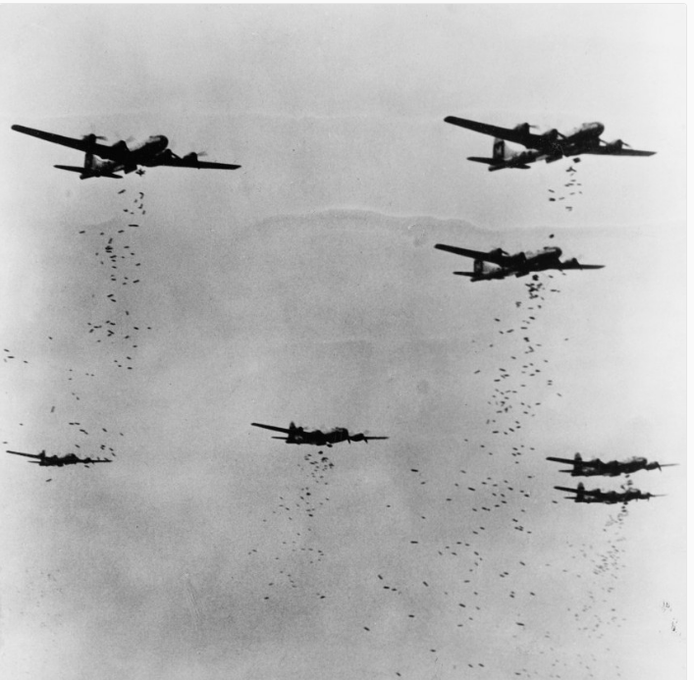
15. The first bomb dropped on Berlin in WWII killed….?
A senior Army officer
An elephant at the zoo
A famous opera singer
A boat captain on the Spree

Slide 31
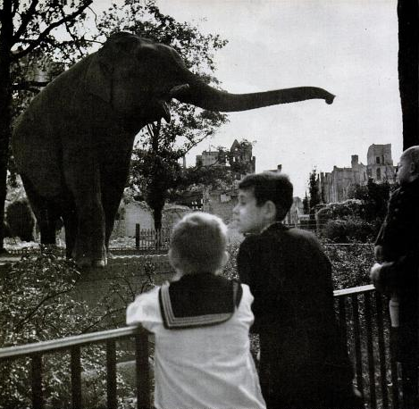
Answer: B
An elephant at the zoo. Actually, 7 of them. Siam, pictured here, was the only surviving elephant.

