Slide 1

Annual General Meeting
December 14, 2016

Slide 2

AWC Berlin
Annual General Meeting 2016
Slide show with photos of activities plays during arrivals and welcome drink

Slide 3
Annual General Meeting 2016
 | AGENDA
Welcome | My-Linh & Michelle | 7:20-7:30
2016 Year in Review | My-Linh | 7:30-7:40
Election of 2017 Board of Directors | Jennifer Post-Dräger & Kathy Aleksic | 7:40-7:50
2017 Club Outlook | 2017 Board | 7:50-8:10
Keynote Speaker | Olivia Schofield | 8:10-8:30
A bit of Moderated Fun! | Claudia Tessier | 8:30-8:45
Close of Business Meeting |  | 8:45

Slide 4
2016 Year in Review

Slide 5
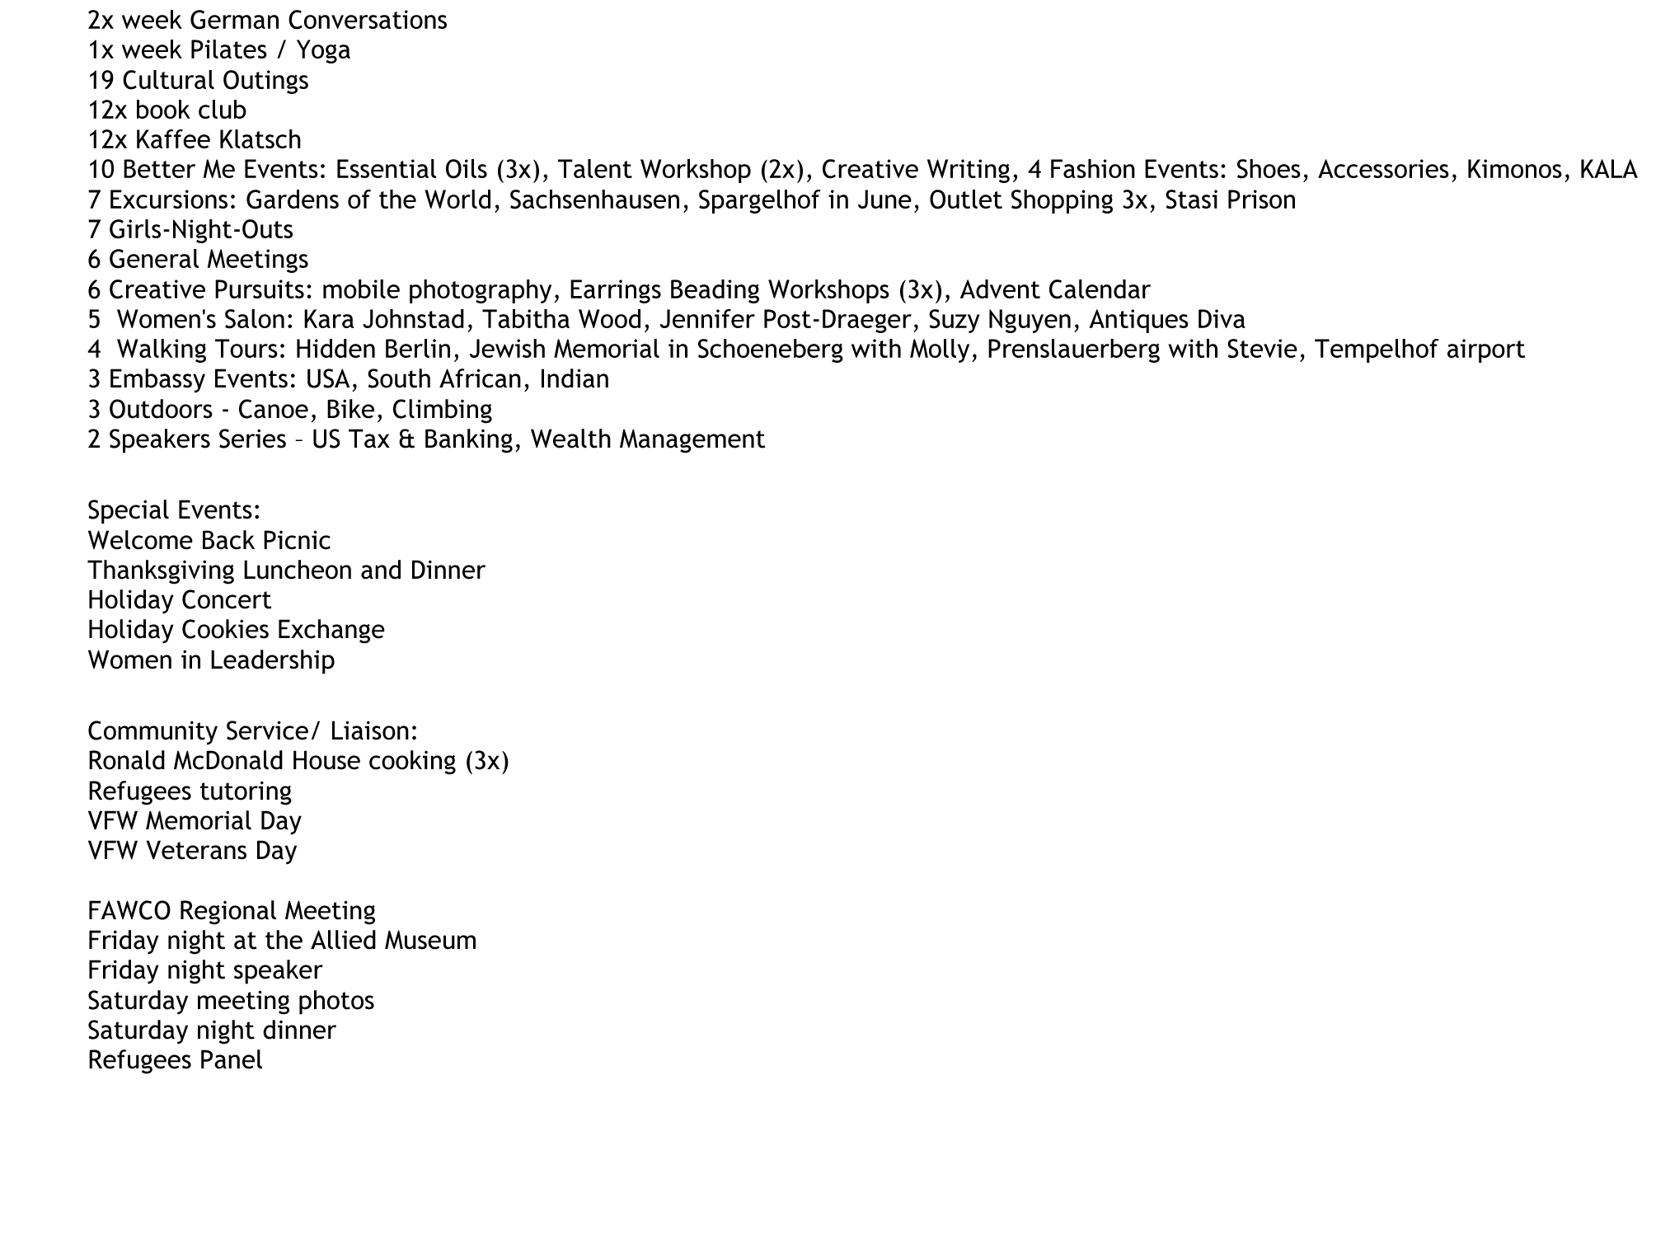
AWC Berlin 2016 – What We Do
We met 213 times in 2016.
160 ²) members in AWC private members only FB Group
My-Linh sent out 2325 ¹⁾ emails.
We hosted 30 speakers
452 ²⁾ likes AWC Berlin public FB page
AWC Berlin was featured 4 times in the news.
2015: 785 emails sent
2015: 273 likes on pubic page and 66 members in private group

Slide 6
AWC Berlin – Who We Are
AWC Berlin Membership 2015-2016

Slide 7
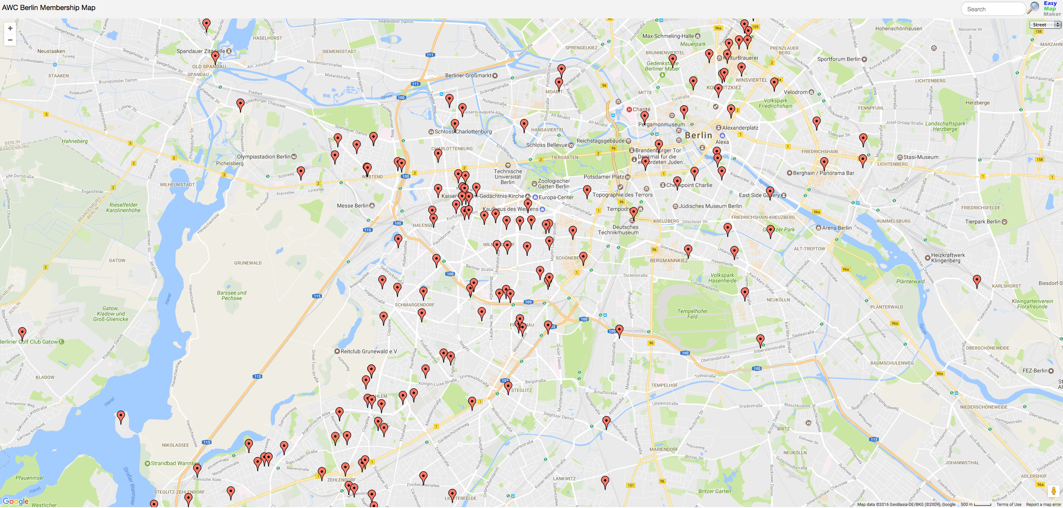
We live all over the city!
Impacts activity locations and neighborhood groups.

Slide 8
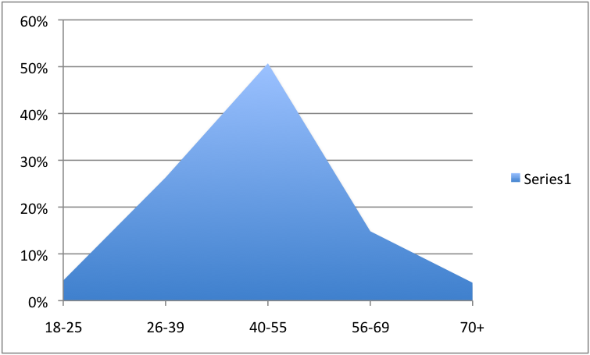
We range from 19 to 86 years old!
51%
26%
15%
4%
4%
Impacts activity types and locations.

Slide 9
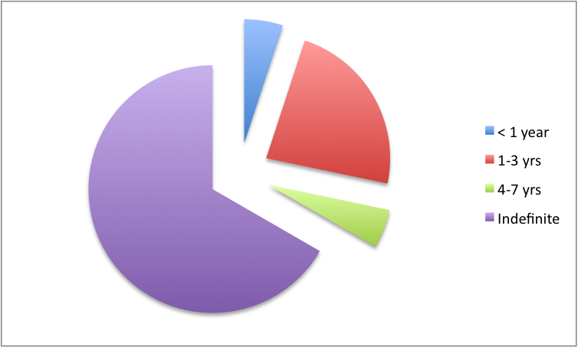
We are committed to Berlin!
5%
23%
66%
5%

Slide 10
AWC Berlin – Who We Are
70% “American” (ie. US passport holders, or husband, children, parents are US passport holders)
21% work full time during the day (ie. evening activities only)
53% came by referral from Friend/Colleague

Slide 11

AWC Berlin –
Cassandra Melvin /
Christine Larkin-Peter //
Chris Krüger //
Claudia Tessier /
Debbie Eisenach //
Heike Lemmelmölke /
Ira Philip /
Karen Axelrad ///
Karen Castellon //
Kate Crook /
Linda Sheehan //
Pat Martin /
Raashi Khanduri /
Silvia Schafhirt /
Theresa Helou /

Slide 12
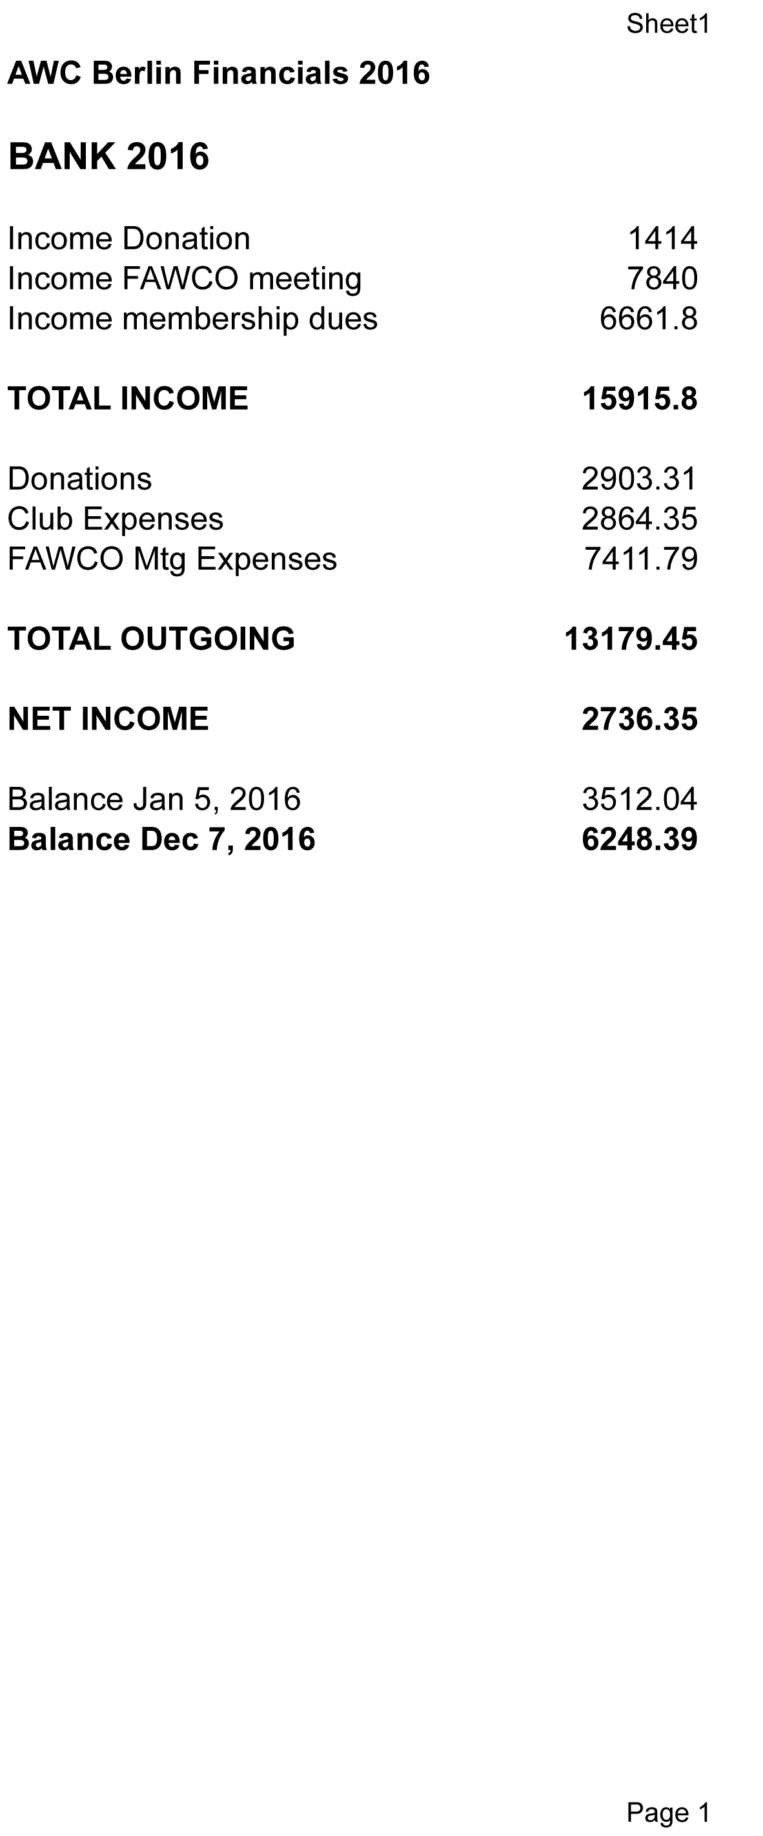
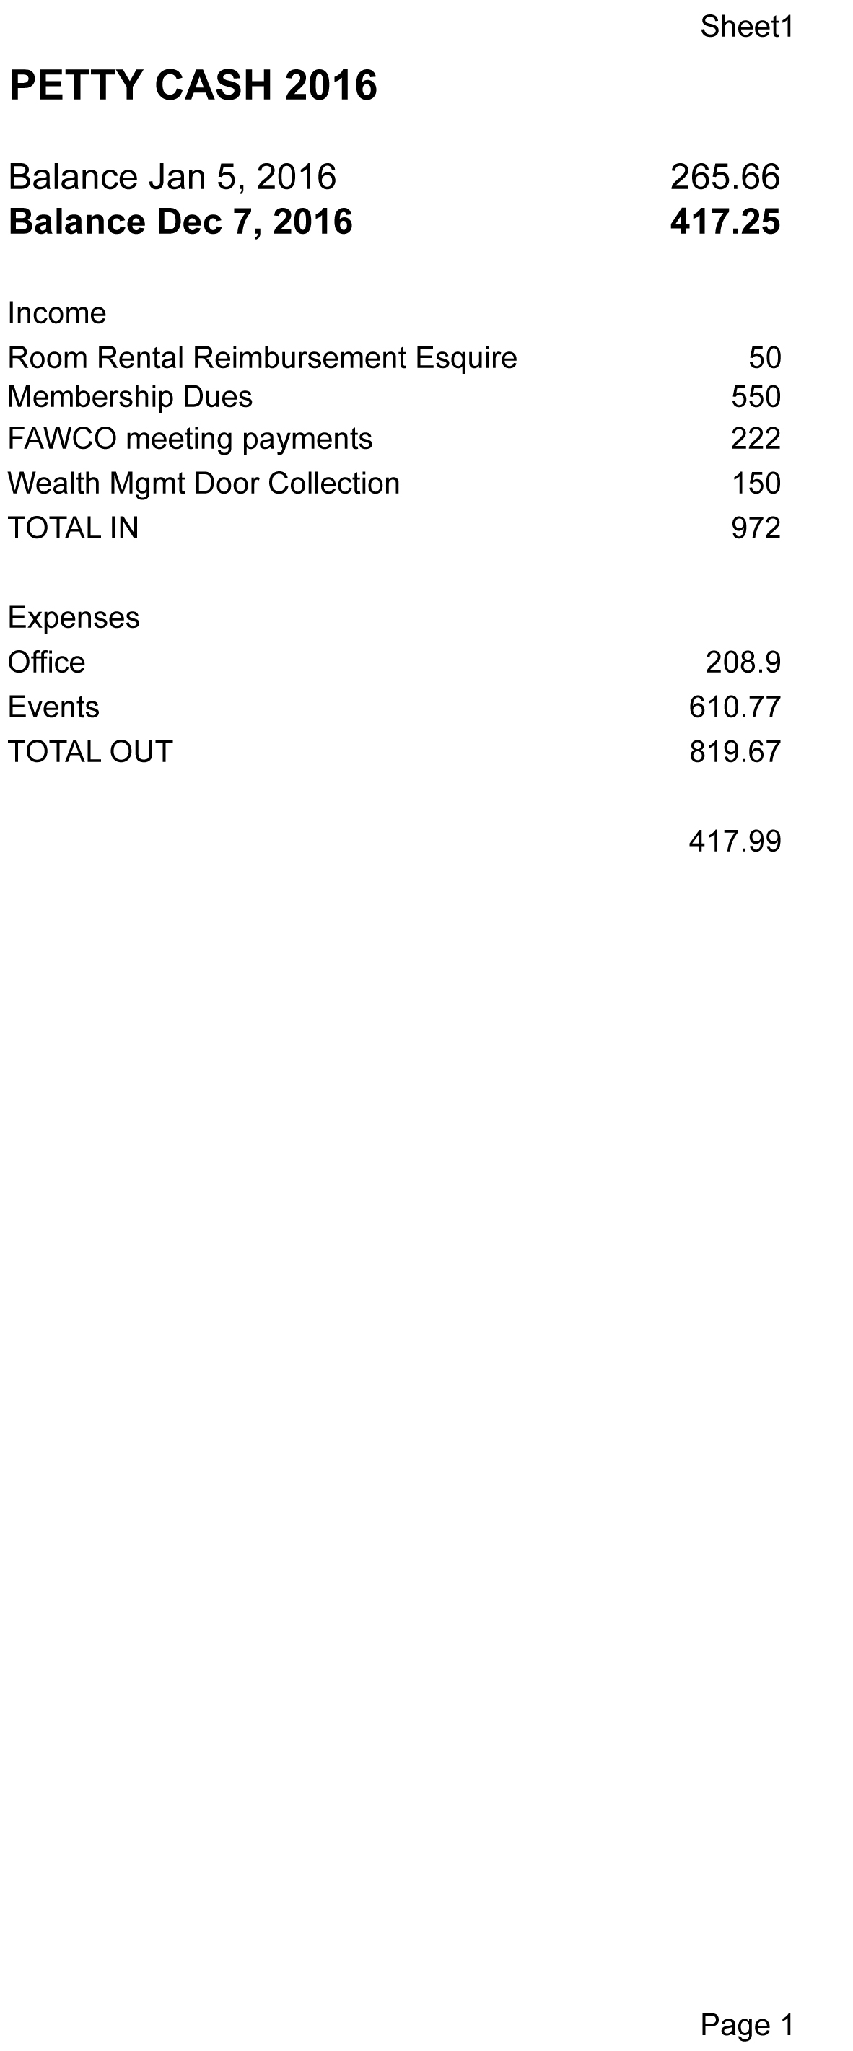
AWC Berlin – How we do it
*
* FAWCO Target Prorgram (319 US Tax Session + 1095 Robin Goldsby)

Slide 13
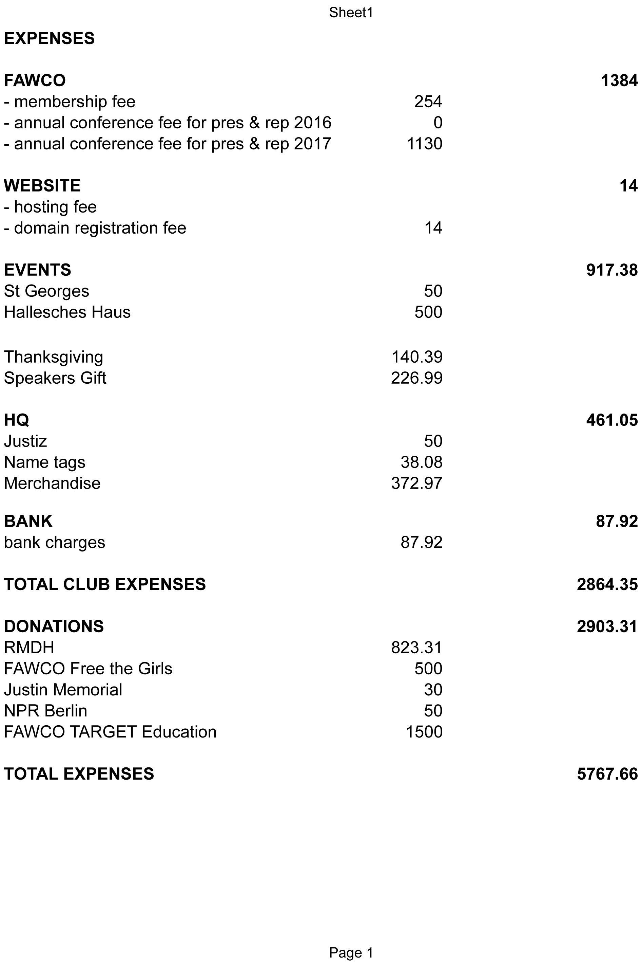
AWC Berlin – How we do it

Slide 14

Thank You to our 2016 Volunteers
Newsletter Editor: Kynya Jacobus
Blog Editor: Molly Brown
Membership Co-Chairs: Dayna Stern & Karen Castellon
FAWCO Meeting Registrar: Rose Finlay
Photographers: Karen Axelrad, Susanne Ollmann
Community Service:
Ronald McDonald House: Nicki Herbers & Angelika McLarren
Refugees Tutoring, Panel: Molly Brown
Activities:
Beading: Susanne Ollmann
Book Club: Linda Sheehan & Claudia Tessier
Evening Events: Nancy Dörbandt & Renee Burke
Excursions/Special Events: Shweta Gupta & Nisha Missigbrodt
Fashion Events: Olga Johnston
German Conversations: Linda Sheehan & Theresa Helou
Outdoors Berlin: Dayna Stern
Women’s Salon: Jennifer Cripe

Slide 15
Election
2017 Board of Directors

Slide 16
Election of 2017 Board of Directors
Voting Chairs:
Jennifer Post-Dräger
Kathy Aleksic

Slide 17

Nominees for 2017 Board of Directors
Officers are elected at Annual General Meeting with a simple majority vote of the quorum of the voting membership. Quorum is ten percent (10%) of current voting members. Method of voting will be by hand, unless a closed paper vote is requested ahead of time by a member.
The Nominees for AWC Berlin Board of Directors 2017 are:
My-Linh Kunst - President
Rebecca Duke - First Vice President, Programs
Karen Castellon - Second Vice President, Membership
Claudia Tessier - Secretary
Jennifer Padfield – Treasurer
→ Nominations from the floor?

Slide 18
Election of 2017 Board of Directors
The Nominees for AWC Berlin Board of Directors 2017 are:
My-Linh Kunst - President
Rebecca Duke - First Vice President, Programs
Karen Castellon - Second Vice President, Membership
Claudia Tessier - Secretary
Jennifer Padfield – Treasurer
All in Favor – please raise your hand
All Against – please raise your hand
All who Abstain – please raise your hand

Slide 19
2017 Club Outloook

Slide 20
2017 Club Outlook
Programs - Becky Duke
Membership – Karen Castellon
Financials – Jennifer Padfield

Slide 21

First VP – Programs: Becky Duke
Regular Activities:
Kaffee Klatsch
General Meetings
Special Events:
July 4th/ Summer
Welcome Back
Thanksgiving
Holiday / AGM
Community Service
Philanthropy
Special Interest:
Culture
Outdoors/Active
Family-Friendly
Development/Educational

Slide 22

Culture
Book Club
Concerts/Theater/Dance/Opera
Languages
Cooking
Embassies
Excursions
Evening Girls-Night-Out
Dining Out with Partners
Lectures
Museums/Galleries
Travel Discussion group

Slide 23

Outdoors/Active
Bike Rides
Running Group / Special Races
Walking / Hiking (with dogs)
Tennis group
Yoga/Pilates
Berlin outings
-Sailing on Wannsee
-Wannsee Beach
-Spree River Cruise
  Dance lessons
Walking Tours
Sports outings: Herta, ice hockey, basketball …

Slide 24

Family-Friendly
Zoo
Dahlem Dorf
Circus
Playgrounds
Pizza-making party
Picnic/cookout
Mommy & Me

Slide 25
Development/Educational
Women’s Salon
The “Better Me” Workshops (self-development)
Women & Leadership
Creative Pursuits
Issues Discussion Group

Slide 26
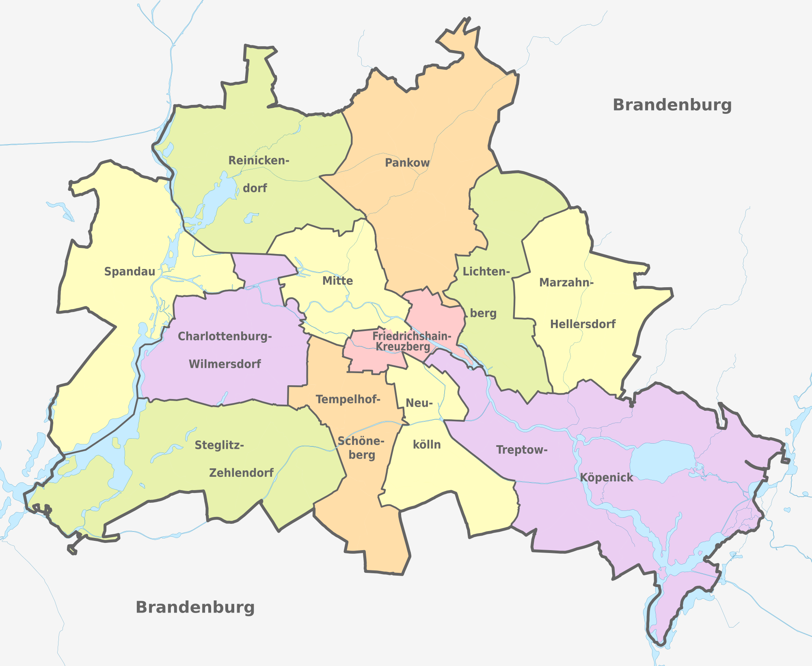
Neighborhood Brainstorm

Slide 27
2nd VP – Membership: Karen Castellon
2017 Membership Goals
Recruitment
(New) Members Engagement

Slide 28
Treasurer – Jennifer Padfield
Renewals
2017 Budget
Philanthropic Committee

Slide 29
Keynote Speaker: Olivia Schofield

